Slide 1
Address Resolution Protocol (ARP)

Slide 2
Address Resolution Protocol (ARP)
Address Resolution Protocol (ARP) is a communication protocol used to find the MAC (Media Access Control) address of a device from its IP address.
This protocol is used when a device wants to communicate with another device on a Local Area Network or Ethernet.
Protocol that is used to resolve IP addresses to MAC addresses.

Slide 3
Address Resolution Protocol (ARP)
The MAC address is a physical address of a device. It's a globally unique number that is assigned to every network interface card.
Whenever a device needs to communicate with another device on a local area network, it needs the MAC address for that device and devices use ARP to acquire the MAC address for that device.
So as an example let's say that computer A wants to communicate with computer B.
Now computer A already knows the IP address for computer B. But in order to communicate with computer B, it still needs its MAC address.
IP address is used to locate a device on a network and the MAC address is what identifies the actual device.

Slide 4
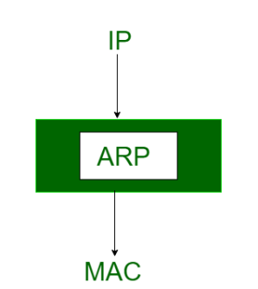
ARP
The ARP’s main task is to convert the 32-bit IP address (for IPv4) to a 48-bit MAC address.
This protocol is mostly used to determine the hardware (MAC) address of a device from an IP address.

Slide 5
WORKING OF ARP
1. When a host tries to interact with another host, an ARP request is initiated. If the IP address is for the local network, the source host checks its ARP cache to find out the hardware address of the destination computer.
2. If the correspondence hardware address is not found, ARP broadcasts the request to all the local hosts.
3. All hosts receive the broadcast and check their own IP address. If no match is discovered, the request is ignored.
4. The destination host that finds the matching IP address sends an ARP reply to the source host along with its hardware address, thus establishing the communication.
5. The ARP cache is then updated with the hardware address of the destination host.

Slide 6
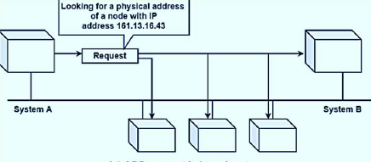
ARP Request Broadcast

Slide 7
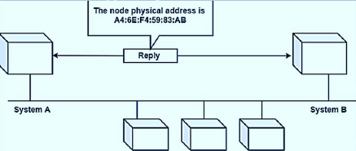
ARP Reply ( unicast )

Slide 8
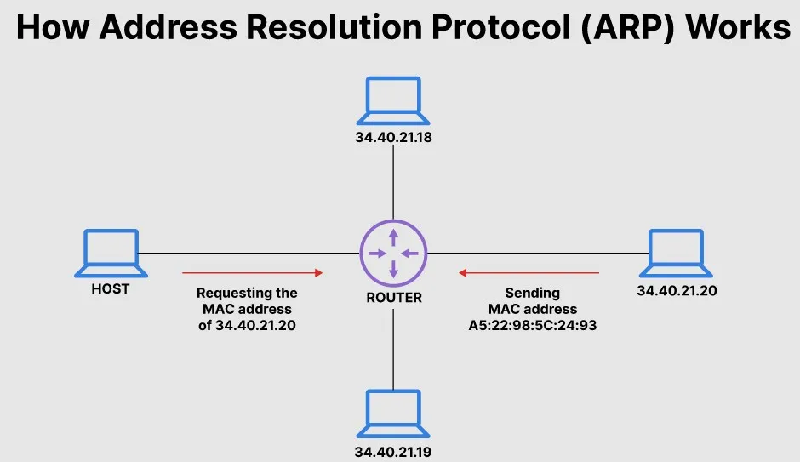

Slide 9
Important ARP terms:
ARP Cache: After resolving the MAC address, the ARP sends it to the cache stored in a table for future reference. The subsequent communications can use the MAC address from the table.
ARP Cache Timeout: It is the time for which the MAC address in the ARP cache can reside.
ARP request: Broadcasting a packet over the network to validate whether we came across the destination MAC address or not.
ARP response/reply: The MAC address response that the source receives from the destination aids in further communication of the data.

Slide 10
Types of ARP
There are four types of Address Resolution Protocol, which is given below:
Proxy ARP
Gratuitous ARP
Reverse ARP (RARP)
Inverse ARP

Slide 11
Types of ARP
Proxy ARP
Proxy ARP is a technique by which a proxy device on a given network answers the ARP request for an IP address that is not on that network. The proxy is aware of the location of the traffic's destination and offers its own MAC address as the destination.
Gratuitous ARP
Gratuitous ARP is almost like an administrative procedure, carried out as a way for a host on a network to simply announce or update its IP-to-MAC address. Gratuitous ARP is not prompted by an ARP request to translate an IP address to a MAC address.
Reverse ARP (RARP)
Host machines that do not know their own IP address can use the Reverse Address Resolution Protocol (RARP) for discovery.
Inverse ARP (IARP)
Whereas ARP uses an IP address to find a MAC address, IARP uses a MAC address to find an IP address.

Slide 12
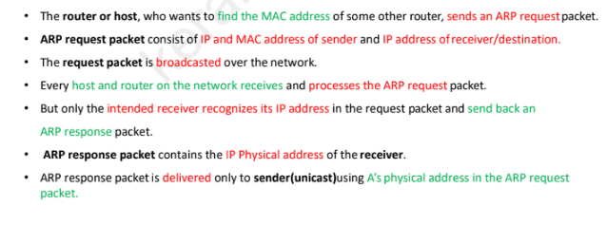
ARP Packet Format

Slide 13
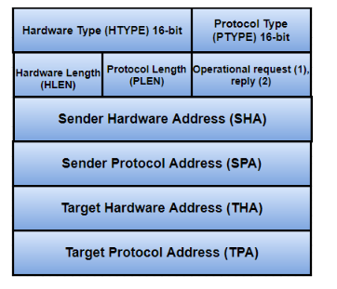
ARP Packet Format

Slide 14
ARP Packet Format
Hardware Type:
This is to specify the type of hardware used by the local network to transmit the Address Resolution Protocols message. Once common hardware under this category would be the ‘Ethernet’ with a value equal to 1, and field size would be 2.
Protocol Type:
This field is the complement of the Hardware Type field, specifying the type of layer three addresses used in the message. For IPv4 addresses, this value is 2048
Hardware length:
This is the length in bytes for the MAC address;Ethernet has a MAC address of 6 bytes long.
Protocol length:
It represents the length of the IPV4 logical address, IPV4 address are generally 4 bytes long.

Slide 15
ARP Packet Format
Operational reqest reply or OPER:
it specifies the nature of the ARP message. An ARP Request has an assigned value of 1, whereas the ARP reply holds the value of 2.
Sender hardware address or MAC address:
This field specifies the physical address of the sender.
Sender IP address or sender protocol address:
This field is used to determine the logical address of the sender
Target hardware address or MAC address:
specifies the physical address of the target.
Target IP address or target protocol address:
This field determines the logical address of the target.

Slide 16
Reverse Address Resolution Protocol (RARP)

Slide 17
Reverse Address Resolution Protocol (RARP)
RARP is a protocol that is responsible for the translation of Physical Address (MAC address) to IP address.
Hosts like diskless workstations only have their hardware interface addresses or MAC address, but not their IP addresses.
They must discover their IP addresses from an external source, usually via RARP protocol.
The reverse address resolution is performed the same way as the ARP address resolution. The same packet format is used for the ARP.
An exception is the operation code field that now takes the following values−
3 for RARP request
4 for RARP reply

Slide 18
RARP server
Some devices in the network are as configured to act as RARP servers
A network administrator creates a table in a RARP server that maps the physical interface or media access control (MAC) addresses to corresponding IP addresses.
This table can be referenced by devices seeking to dynamically learn their IP address.

Slide 20
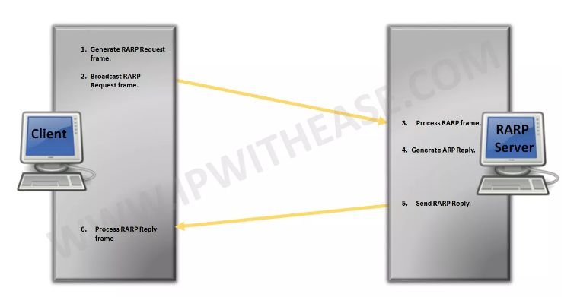
Steps to Achieve the IP Address from RARP Server:

Slide 21
Working of RARP
Source Device Generates RARP Request Message and Broadcasts RARP Request Message
Local Devices Process RARP Request Message
RARP Server Generates RARP Reply Message:
RARP Server Sends RARP Reply Message
Source Device Processes RARP Reply Message:

Slide 22
Working of RARP
Source Device “Generates RARP Request Message” – The source device generates a RARP Request message. The Source puts its own data link-layer address as both the Sender Hardware Address and also the Target Hardware Address. It leaves both the Sender Protocol Address and the Target Protocol Address blank.
Source Device “Broadcasts RARP Request Message” – The source broadcasts the ARP Request message on the local network.
Local Devices “Process RARP Request Message” – The message is received by each device on the local network and processed. Devices that are not configured to act as RARP servers ignore the message.
RARP Server Generates RARP Reply Message: Any device on the network that is a RARP server responds to the broadcast from the source device. It generates a RARP Reply and sets the Sender Hardware Address and Sender Protocol Address to its own hardware and IP address of course. It then sets the Target Hardware Address to the hardware address of the original source device. It looks up in a table the hardware address of the source, determines that device’s IP address assignment, and puts it into the Target Protocol Address field.
RARP Server Sends RARP Reply Message: The RARP server sends the RARP Reply message unicast to the device looking to be configured.
Source Device Processes RARP Reply Message: The source device processes the reply from the RARP server. It then configures itself using the IP address in the Target Protocol Address supplied by the RARP server.

Slide 23
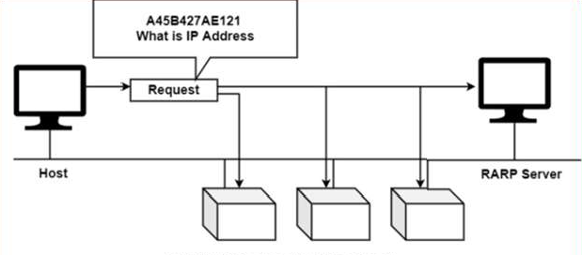
RARP Request Broadcast

Slide 24
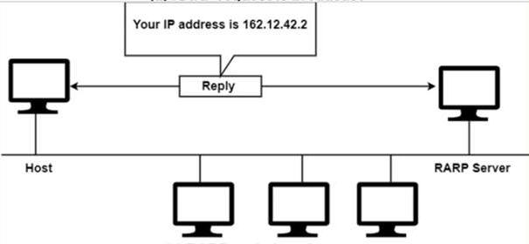
RARP Reply

Slide 25
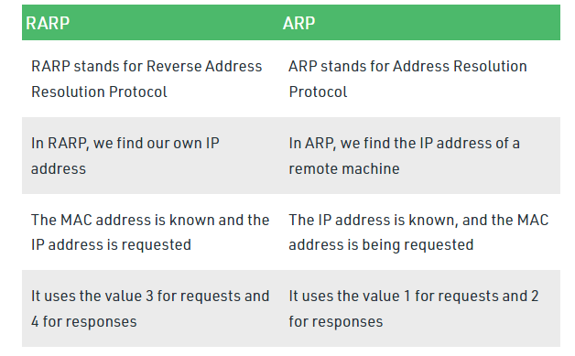
Difference between ARP and RARP

Slide 26
Problems with RARP
There is a serious problem with RARP:
Broadcasting is done at the data link layer.
RARP is a link layer protocol and the problem of RARP is that you can’t route these packets. You need a RARP server on every subnet.
The physical broadcast address, all is in the case of Ethernet, does not pass the boundaries of a network.
This means that if an administrator has several networks or several subnets, it needs to assign a RARP server for each network or subnet. This is the reason that RARP is almost obsolete.
Two protocols, BOOTP and DHCP replaces RARP

